Slide 1

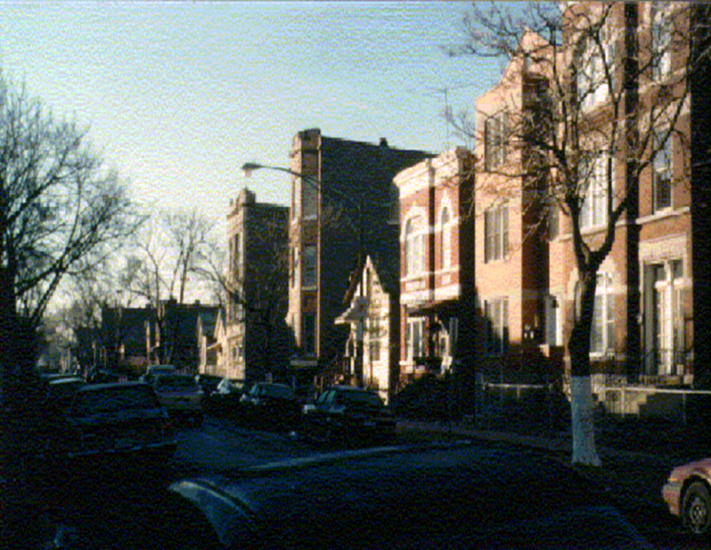
How Indoor Environmental Hazards Harm Children and their Families
Helen Binns, MD, MPH
Version 02-2013

Slide 2
Disclosure Information
Funding for lead poisoning prevention efforts through a contract from the Illinois Department of Public Health with Lurie Children’s.
Funding from the Great Lakes Center for Children’s Environmental Health via subcontract between University of Illinois at Chicago with Lurie Children’s.
The Great Lakes Center for Children’s Environmental Health is a Pediatric Environmental Health Specialty Unit (PEHSU), which is under the Association of Occupational and Environmental Clinics (AOEC) -- funded by the Agency for Toxic Substances and Disease Registry (ATSDR) and the U.S. Environmental Protection Agency (EPA).

Slide 3
PEHSU Program Disclaimer
This material was supported by the Association of Occupational and Environmental Clinics (AOEC) and funded under the cooperative agreement award number 1U61TS000118-03 from the Agency for Toxic Substances and Disease Registry (ATSDR).
Acknowledgement: The U.S. Environmental Protection Agency (EPA) supports the PEHSU by providing funds to ATSDR under Inter-Agency Agreement number DW-75-92301301-0. Neither EPA nor ATSDR endorse the purchase of any commercial products or services mentioned in PEHSU publications.

Slide 4


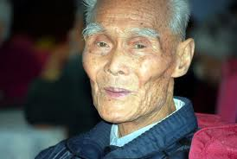
Across the ages….
What starts here
Lasts a Lifetime!

Slide 5
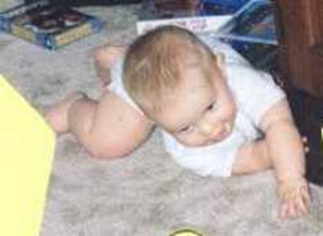
Child’s Eye View
Young children spend most of their time indoors – often at home
  Children spend 1-2 hours/day on the floor
Children learn by exploring, touching, mouthing, tasting
  Infants put food, hands, or objects in their mouth about 28 times/hour

Slide 6
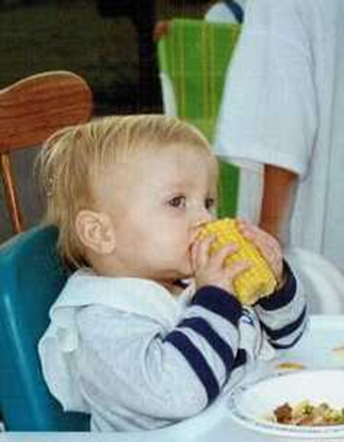
Pound for pound, children breathe more, eat more, and drink more than adults
An infant’s average air intake is twice the level of a resting adult’s air intake
A young child eats 3-4 times more food per pound of body weight compared to an average adult
So, toxics ingested obtain higher concentration in children than adults

Slide 7
Asthma
Most prevalent chronic medical condition in childhood
Prevalence is rising
  9.5% of children
  7.7% of adults
CDC 2009

Slide 8
What is Asthma?
A chronic disease of the medium and small airways in the lung
Airways are hypersensitive to certain “triggers” in the environment
Asthma cannot be cured, but its symptoms can be controlled with proper environmental changes and medication
Notes:
I would like to start with a common definition of asthma. Asthma is a chronic disease of the medium and small airways in the lung. These airways are hypersensitive to certain “triggers” in the environment. Asthma cannot be cured but its symptoms can be controlled with proper environmental changes and medication.

Slide 9
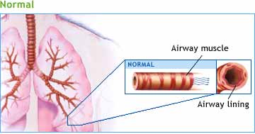
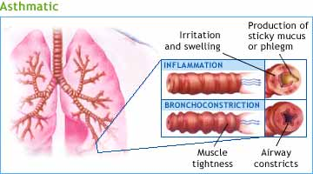
Asthma is a Serious Disease
Asthma attacks -- allergic reactions to triggers or exposures
Airways swell and fill with mucus and secretions
Muscles around the airways contract and spasm
Airways can collapse from excess swelling and spasm, causing shortness of breath, even death
Notes:
Asthma attacks are allergic reactions to triggers or exposures and each person with asthma has different conditions that can trigger an asthma attack. During an attack, The airways swell and fill with mucus and The muscles around the airways contract. As the airways swell and muscles contract, Airways can collapse from excess swelling and spasm, causing shortness of breath and even death. How many people here have asthma? Can someone describe how an asthma attack feels? The way I like to describe it is to picture what it is like to breath through a paper towel holder. Its basically like breathing normally. Now try breathing through a coffee stirrer, because that is how small the airways shrink. Try and catch your breath. It is almost impossible.

Slide 10
Asthma
Highest prevalence among
  Females
  Blacks
  Living in poverty
Health care usage – annual visits
  47/100 outpatient
  8/100 emergency department
  2/100 hospitalized

Slide 11
Risks for Asthma Begins In-Utero!
(makes it easy to develop hyper-responsiveness to triggers)
Smoking in pregnancy
Oxidative stress leading to inflammation and cell death
  tobacco smoke, diesel exhaust
  unhealthy diet
  low fresh fruits, vegetables, fish
Organic compounds
  Like PCB, pesticides, dioxins, phthalates
  Even at very low levels these compounds increase risk for allergic response
Microbial exposure (farm life protects)
Maternal asthma/allergic status
Maternal stress, corticosteroid use, pre-eclampsia
Martino D. Chest 2011;139:640-647
Notes:
Dioxins – produced in burning (trash) and herbicide production. In dirt -- agent orange.
Organochlorine pesticides -- The organochlorine chemicals endosulfan, dieldrin, and γ-hexachlorocyclohexane (lindane) are persistent pesticides to which people are exposed mainly via diet. Their antagonism of the γ-aminobutyric acid-A (GABAA) receptor makes them convulsants. They are also endocrine disruptors because of their interaction with the estrogen receptor (ER).

Slide 12
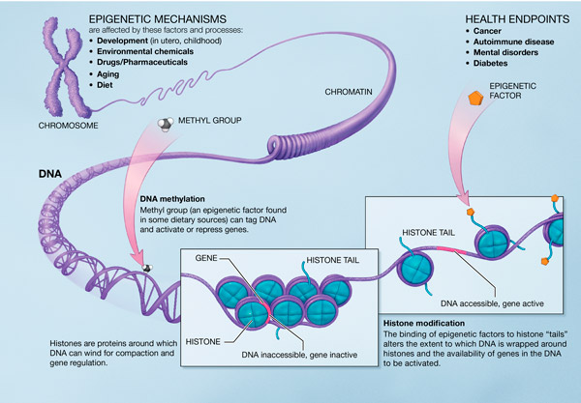
Environmental Exposures May Change Biologic Risk
Attachments to the DNA change how tightly DNA is coiled
This leads to alterations of gene expression
http://nihroadmap.nih.gov/epigenomics/epigeneticmechanisms.asp
Notes:
Dabelea, D., Hanson, R. L., Lindsay, R. S., Pettitt, D. J., Imperatore, G., Gabir, M. M., Roumain, J., Bennett, P. H. & Knowler, W. C. (2000) Intrauterine exposure to diabetes conveys risks for type 2 diabetes and obesity. Diabetes 49:2208-2211
Whitaker study After controlling for the birth weight, birth year, and gender of the children plus the mothers' age, race/ethnicity, education level, marital status, parity, weight gain, and smoking during pregnancy, the relative risk of childhood obesity associated with maternal obesity in the first trimester of pregnancy was 2.0 (95% confidence interval [CI]: 1.7-2.3) at 2 years of age, 2.3 (95% CI: 2.0-2.6) at 3 years of age, and 2.3 (95% CI: 2.0-2.6) at 4 years of age.
PCBs [polychlorinated biphenyls]

Slide 13
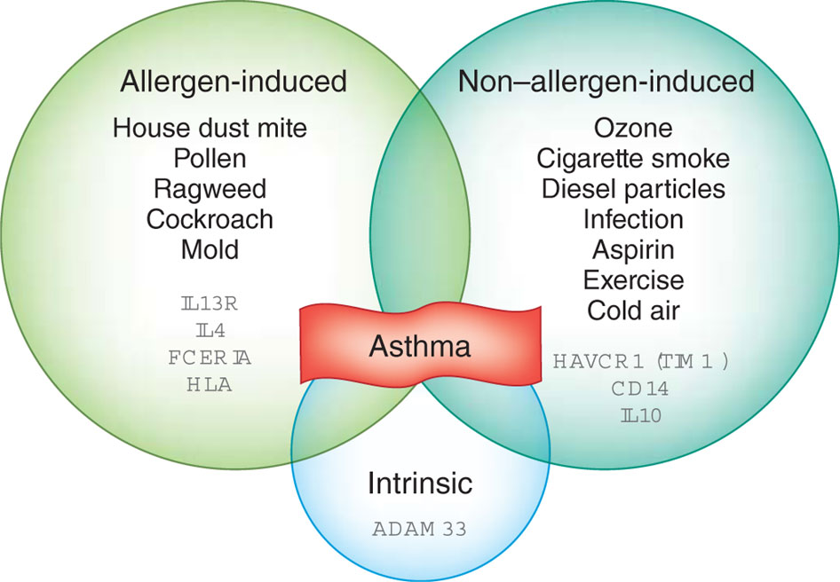
Asthma is Complex
Kim et al. Nature Immunology 2010;11:577–584
Notes:
Asthma is a complex disease caused by multiple factors. There are several different forms of asthma (allergic, non-allergic and intrinsic), and in some patients these forms can coexist. Allergic asthma can be induced by allergens and is mediated by T_{H}2 immune responses. Non-allergic asthma can also be caused by several factors, such as air pollution and infection. Non-T_{H}2 cells and various cells of the immune system other than T_{H}2 cells contribute to non-allergic asthma. Some of the many genes involved in development of spontaneous asthma are presented here.

Slide 14
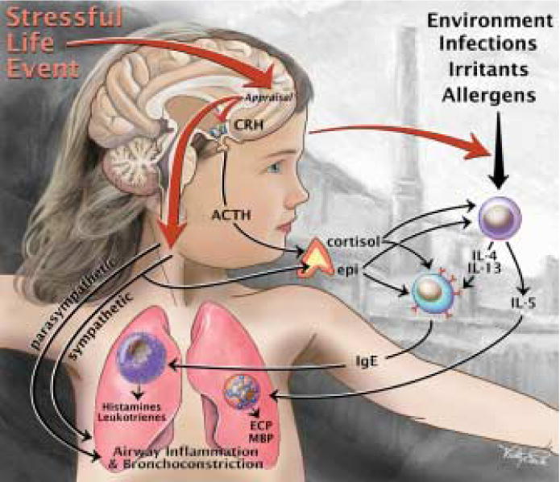
Stress Exacerbates Response to Environmental Triggers

Slide 15
Indoor pollutants may be more important than outdoor pollutants!
*Americans spend more than 90% of their time indoors (home, work, school)
Biologic allergens
  Dust mites
  Cockroaches
  Pets (especially cats)
  Mold
ETS
Irritant chemicals (cleaners)
Particulate matter (combustion: gas stove, wood stove, kerosene heaters)
Ozone

Slide 16
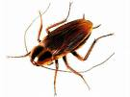
Biologic allergens - cockroaches
36% cockroach sensitization rate in inner-city asthmatic children
Patients/parents may not feel comfortable admitting to infestation

Slide 17

Animal Allergens
Unlikely Interventions
Bathing cats MAY be effective at reducing allergen (n = 8 cats)
  The reduction was not maintained by 1 week¹
  Therefore it had been recommended
  to bathe the cat twice a week…
However, a more recent study of 12
cats suggests the decrease in
dander after bathing lasts about 1 day²
¹Avner DB et al. J Allergy Clin Immunol 1997;100:307-12
²Ownby D et al. J Allergy Clin Immunol 2006:118:521-2

Slide 18
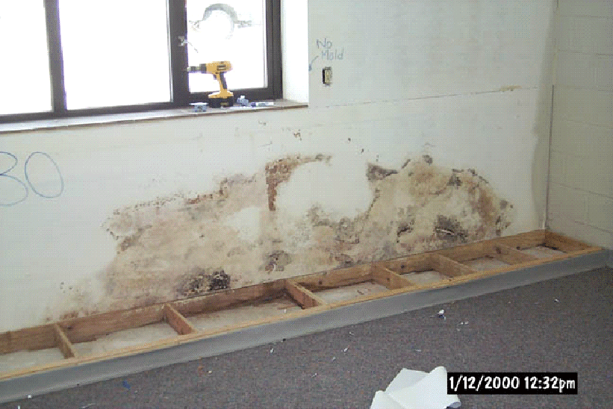
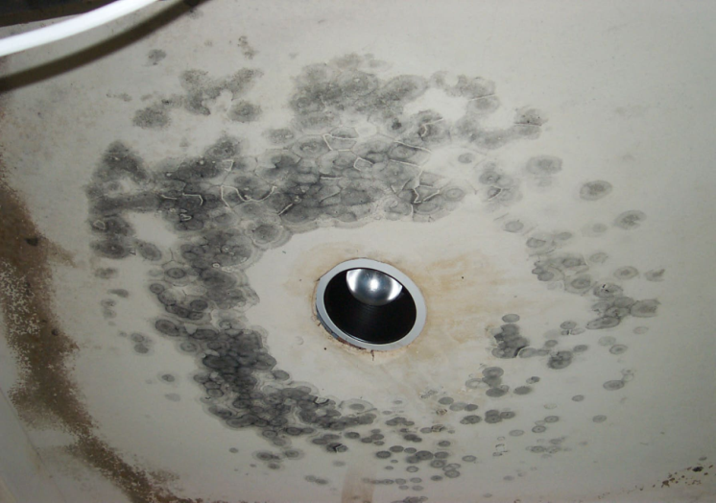
Biologic allergens - mold
60 species of molds are allergenic
Common allergens: penicillium, aspergillus, cladosporium, alternaria

Slide 19
What is secondhand smoke?
Secondhand Smoke (SHS) is the smoke that comes off the end of a smoking cigarette and the smoke that the smoker exhales
Notes:
CITATION:
Harlap, S., Davies, A.M. (1974). Infant admissions to hospital and maternal smoking. Lancet, 1(7857), 529-31.

Slide 20
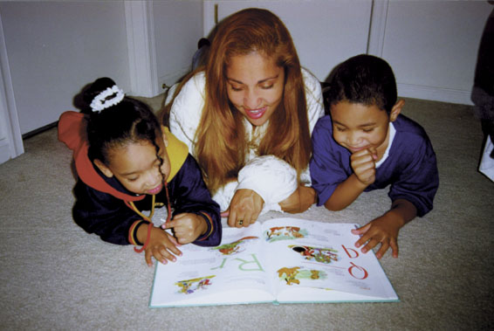
SHS and Children:
Short Term Health Effects
Respiratory tract infections, such as pneumonia & bronchitis
Decreased pulmonary function
Triggers asthma attacks
Ear Infection
Tooth decay
House fires
Notes:
CITATION:
U.S. Department of Health and Human Services. The Health Consequences of Involuntary Exposure to Tobacco Smoke: A Report of the Surgeon General. Atlanta, GA: U.S. Department of Health and Human Services, Centers for Disease Control and Prevention, National Center for Chronic Disease Prevention and Health Promotion, Office on Smoking and Health, 2006.

Slide 21
SHS and Children: Long Term Health Effects
Sudden Infant Death Syndrome (SIDS)
  1 parent smoking -- 2x increased risk
  2 parents smoking -- 5x greater
  (comparatively – prone sleeping 100x risk)
Asthma
  SHS exposure increases frequency of episodes and severity of symptoms
  200,000 annual cases of childhood asthma, attributed to SHS
Possible problems with cognitive functioning and behavioral development
More likely to become smokers
Notes:
CITATION:
Farber, H.J., Knowles, S.B., Brown, N.L., et al. (2008). Secondhand tobacco smoke in children with asthma: sources of and parental perceptions about exposure in children and parental readiness to change. Chest, 133(6), 1367-74.

Slide 22
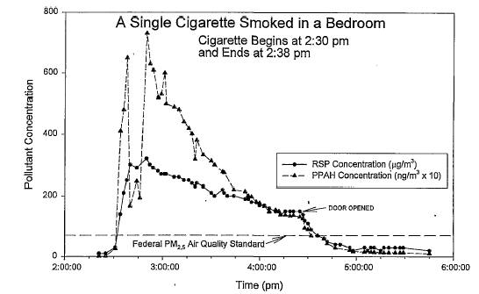
Effect of Cigarette Smoke on
Indoor Air Quality
…it takes TWO hours for the air quality to return to normal for levels of CO, fine particles and particulate aromatic hydrocarbons..
Notes:
This graph from Ott et al in the Journal of Air and Waste Management shows the effect of a single cigarette on indoor air quality. Note the initial spike up in the seven minutes while the cigarette is burning. Then note that it takes two hours for the air quality to return to the minimum federal safety standard for fine particles, CO, and particulate aromatic hydrocarbons. Think about the area under the curve as the true contaminant load of each cigarette. Note that even after 5 hours the air has not returned to zero… contamination remains.
This phenomenon is occurring thousands upon thousands of times a year in multi-unit buildings where children are living.
CITATION:
Ott, W.R., Klepeis, N.E., Switzer, P. (2003). Analytical solutions to compartmental indoor air quality models with application to environmental tobacco smoke concentrations measured in a house. Journal of the Air & Waste Management Association, 53(8), 918-36.

Slide 23
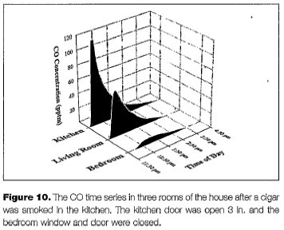
Effect of a cigar smoked in another room on air quality
Notes:
This slide shows the effect of a cigar smoked in the another room on the air quality in the living room and bedroom. Smoke doesn’t know to stop at the doorway, the contamination fills the available space throughout the home and building.
CITATION:
Ott, W.R., Klepeis, N.E., Switzer, P. (2003). Analytical solutions to compartmental indoor air quality models with application to environmental tobacco smoke concentrations measured in a house. Journal of the Air & Waste Management Association, 53(8), 918-36.

Slide 24
Injury -- the leading cause of child death
Of all child injuries treated in the Emergency Room,
40% occur in the home

Slide 25
Child Injuries in the Home
2,800 deaths
74,000 Hospitalizations
4 million ER visits
13 million doctor visits

Slide 26
Sources for Injuries
Falls – out of windows; on rugs
Fires
Drowning – pools
Burns – hot water
Furniture falls
Carbon monoxide

Slide 27
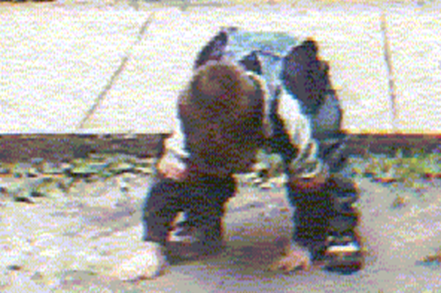
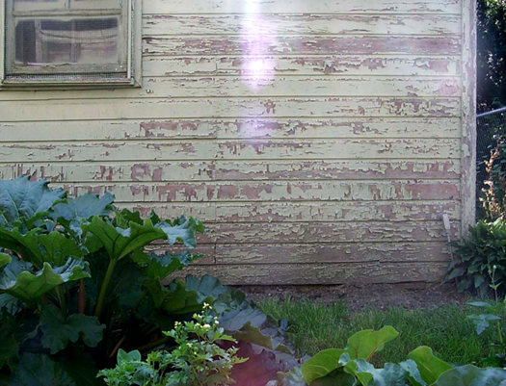
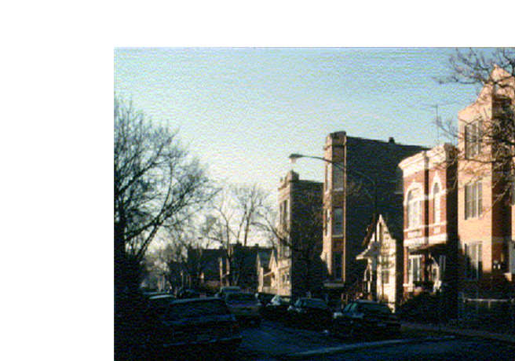
Lead
No safe level
1.3 μg/dL (geometric mean ages 1-5 yrs, 2007-2010)
Risks haven’t changed
  Older housing
  Black/African American
  Low income

Slide 28
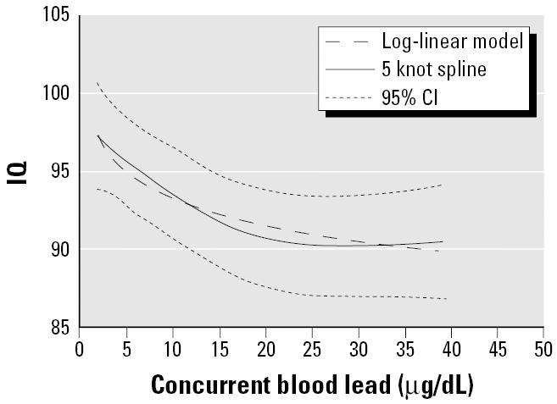
Effect of BLLs 2.5 to 30 μg/dL on IQ
Pooled analysis, 7 studies
  N= 1,333
Increase in lead:
  from 2.4 to 10 μg/dL
    ↓ 3.9 IQ points
  from 10 to 20 μg/dL
    ↓ 1.9 IQ points
  from 20 to 30 μg/dL
    ↓ 1.1 IQ points
Lanphear et al, Environ Health Perspect. 2005 July; 113(7): 894–899.

Slide 29
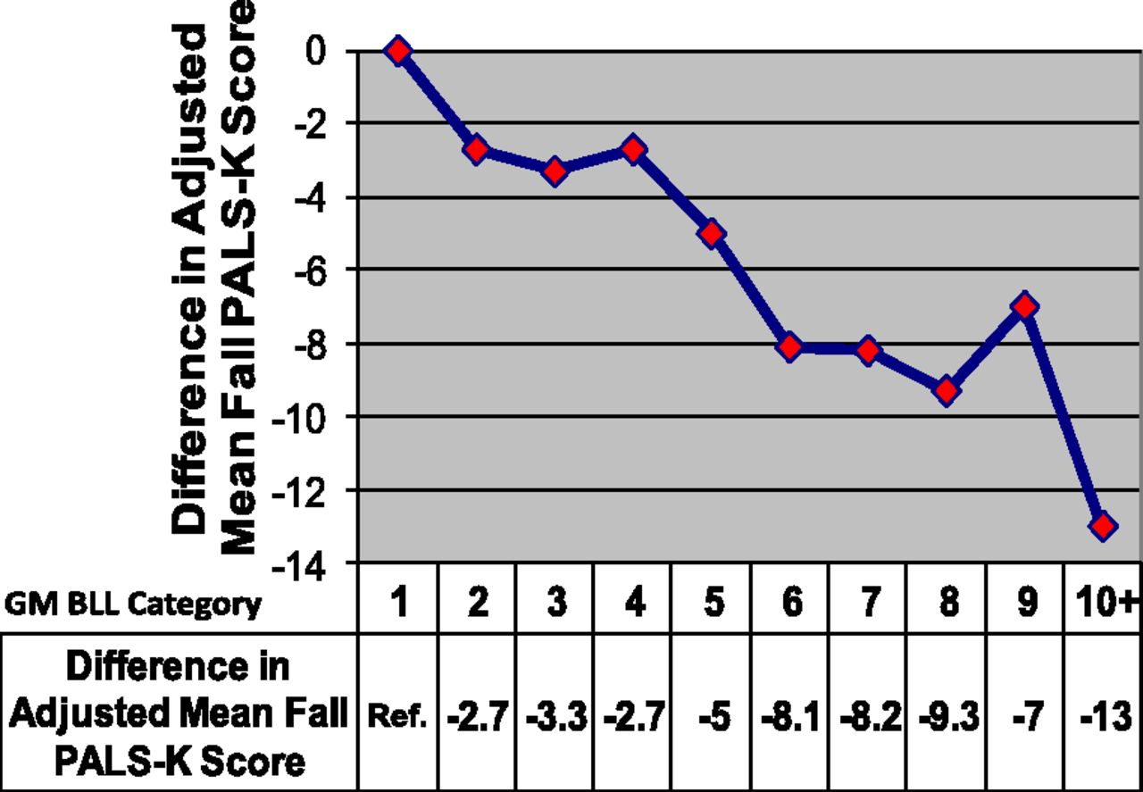

Adjusted differences in mean fall PALS-K scores between refined GM BLL categories compared with the reference category (<2 µg/dL).
McLaine P et al. Pediatrics 2013;131:1081-1089
©2013 by American Academy of Pediatrics
Phonological Awareness Literacy Screening-Kindergarten (PALS-K)
Notes:
Adjusted differences in mean fall PALS-K scores between refined GM BLL categories compared with the reference category (<2 µg/dL). Linear regression model was adjusted for age at the start of kindergarten, gender and year, race, child language, and free/reduced lunch status.

Slide 30
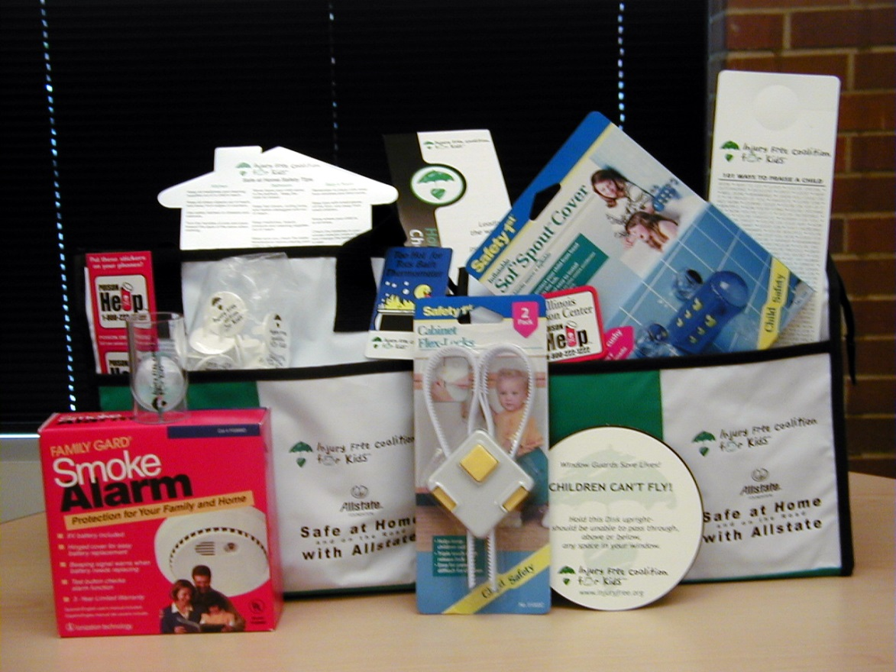
Safe at Home Study
Classes for teen mothers
Safety Kit provided
  smoke detector
  cabinet safety latch
  poison control magnet & stickers
  small parts tester
  bathtub spout cover
  home safety checklist
Pictures of how kit items used
Notes:
The bag contained 12 items which included a smoke detector, cabinet safety latch , poison control magnet and stickers , small parts tester, a bathtub spout cover and a home safety checklist.

Slide 31
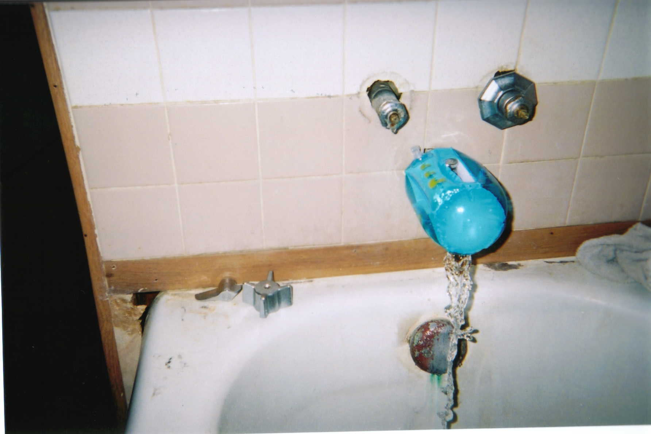
Notes:
We also had some disturbing findings. As you can see, in this picture, the student is correctly using the spout cover, but in her house there are no knobs on the faucets.
The knob has a sharp edge, and could potentially cause more harm to the child than hitting the head on the spout. Given that there are no functioning knobs on the faucet the water may be difficult to control and a child could be burned.

Slide 32
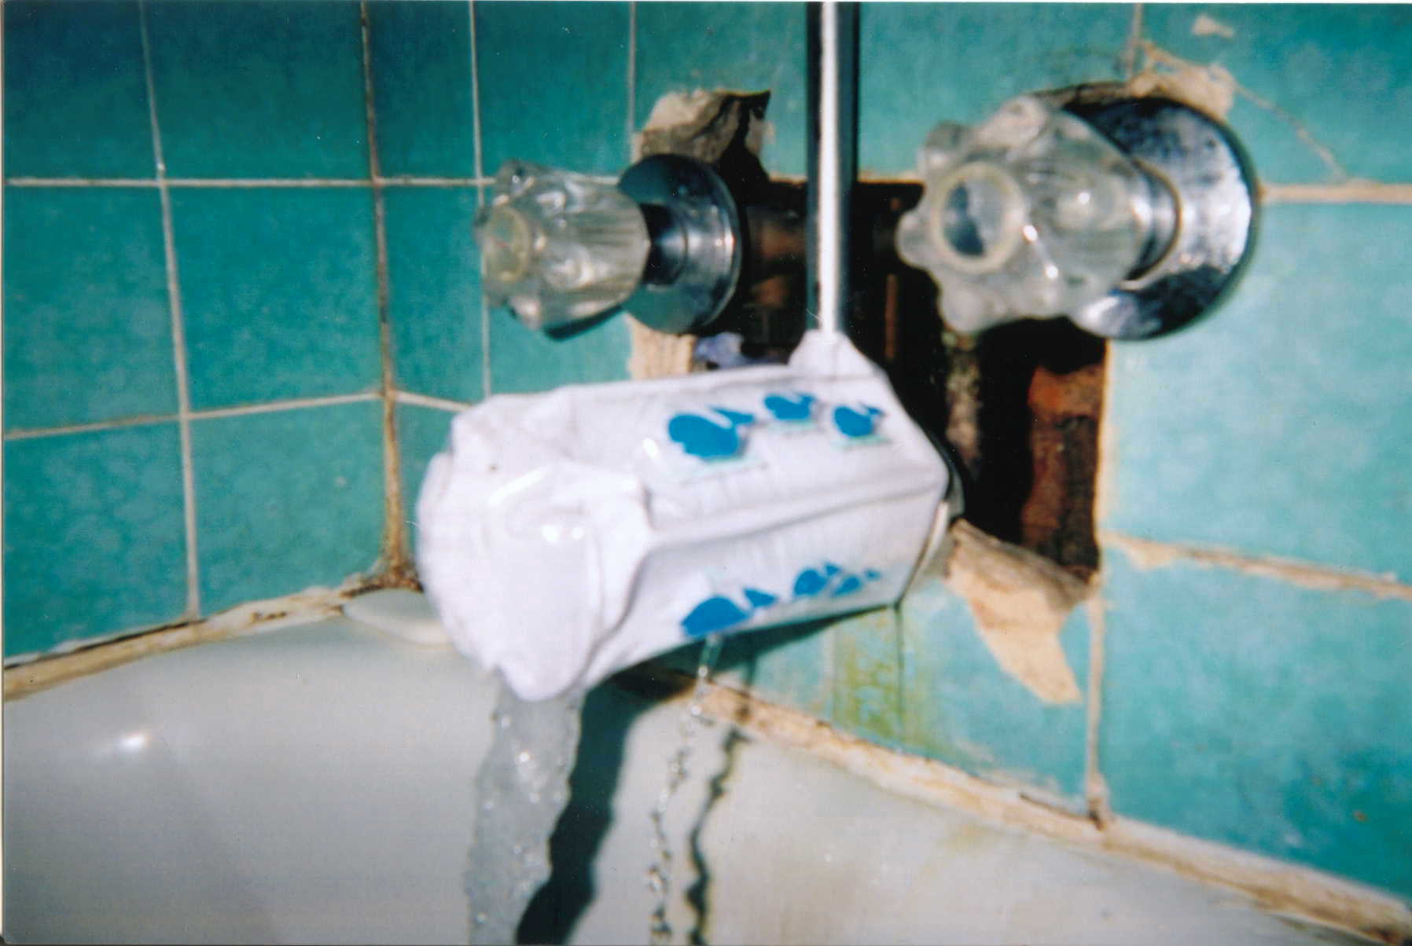
Notes:
Again in this picture, the cover is correctly placed on the spout of the bathtub, but behind the spout there is broken tile and exposed pipes. A child could be burned on the hot water pipe.

Slide 33
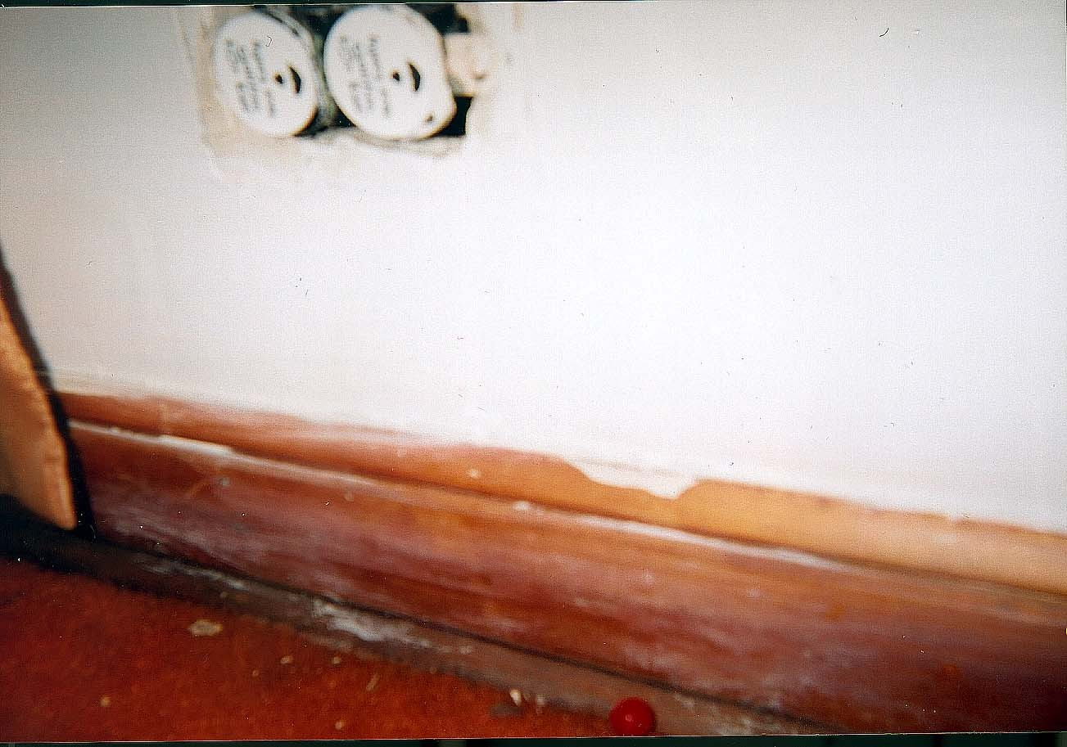
Notes:
Although a little more difficult to see, this picture demonstrates correctly placed outlet covers. If you look closely at the picture, you see that there is a hole in the wall and no plate behind the outlet. Exposed electrical wires are accessible- the outlet covers don’t really get the safety job done.

Slide 34
Summary
Concern for exposure throughout the lifespan
  Risk starts prenatally
Potential for a diverse array of hazards in the home
  Building structure
  Disrepair / water damage
  Toxins transported into a home
  Human behaviors
Working together – we can make a difference!

